Slide 1

Pimpri Chinchwad College of Engineering Pune
Prathamesh Sambhaji Khade(120B1G175)
Sahil Sanjay Rathod (120B1G191)
Guidance:
Amol Dhumane sir

Slide 2
MACHINE LEARNINGIN MECHANICAL ENGINEERING
INOVATIONS IN MACHINE LEARNING

Slide 3
Applications:
Predictive maintenance
Quality control
Product design optimization
Supply chain management

Slide 4
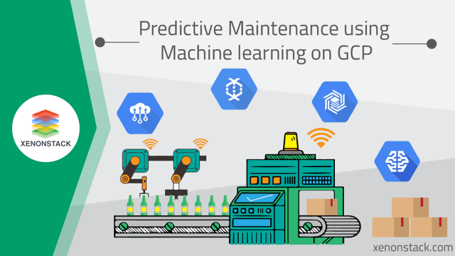
Predictive maintenance

Slide 5
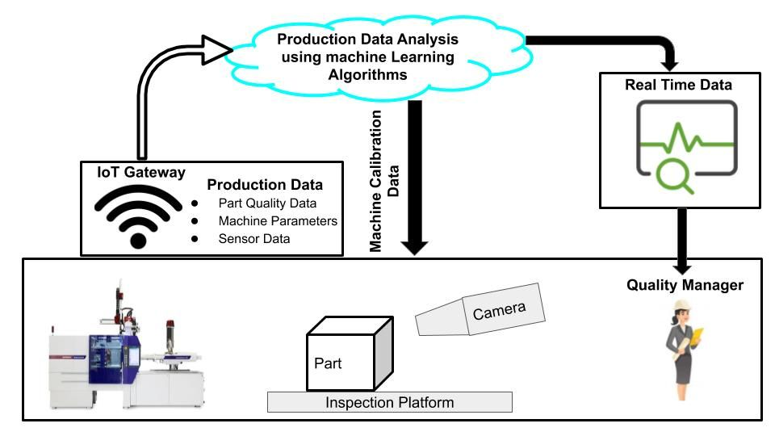
Quality Management

Slide 6

Demand Forecasting

Slide 7
Why in Demand Forecasting ?
Better products
Faster
Lower costs

Slide 8
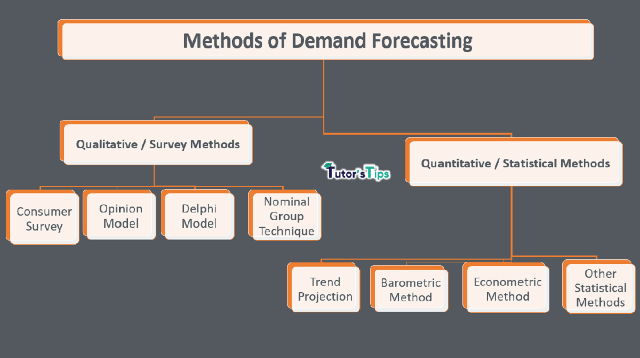

Slide 9
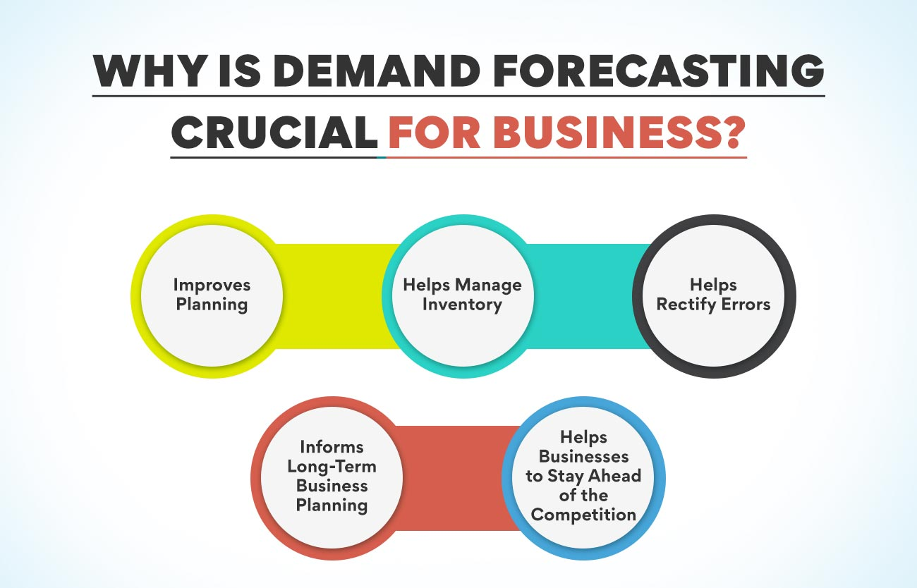

Slide 10
How ML Forecast ?
Analyze sales data
Weather patterns
Social media data

Slide 11
Algorithms:
Decision trees
Random forests
Gradient boosting
Neural networks

Slide 12
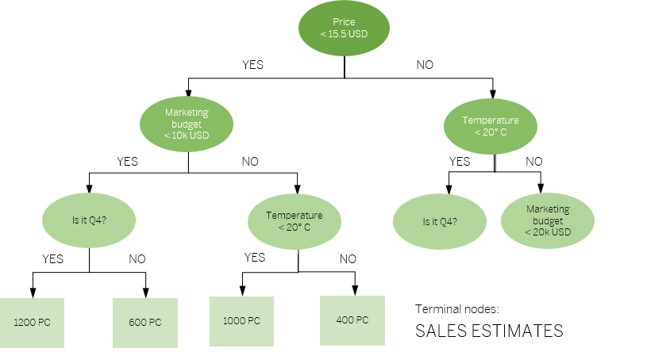
Decision Trees

Slide 13
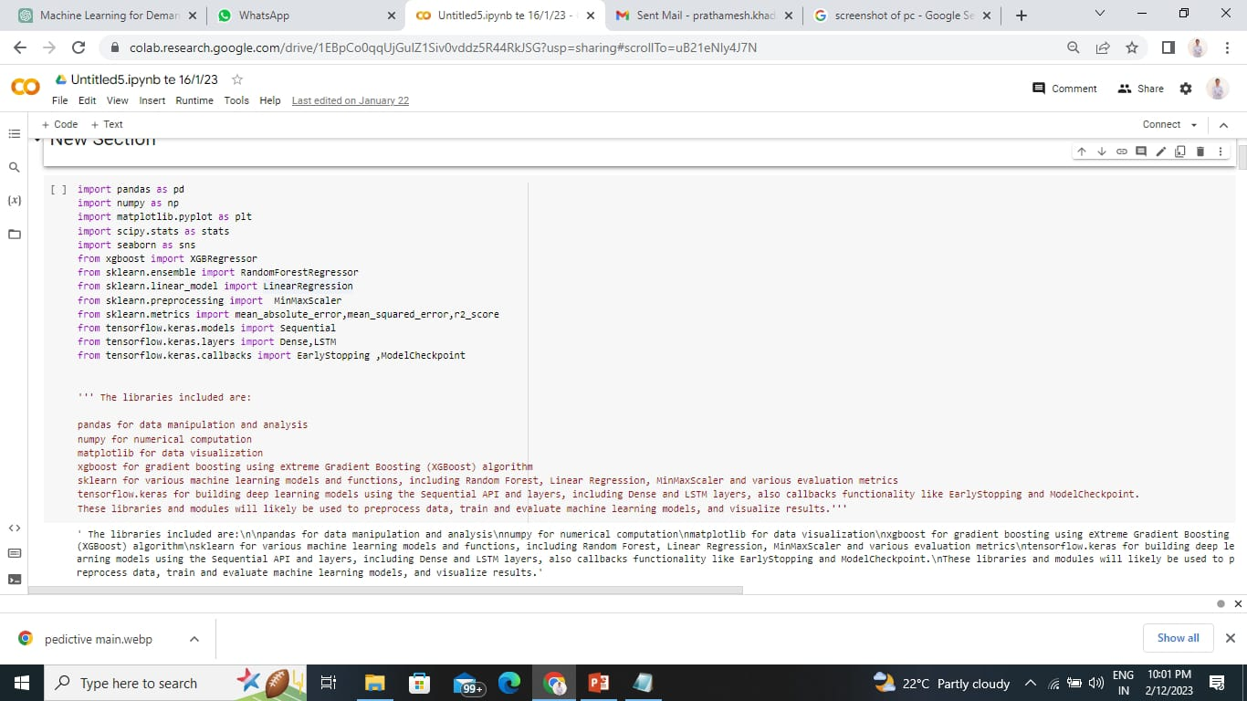

Slide 14
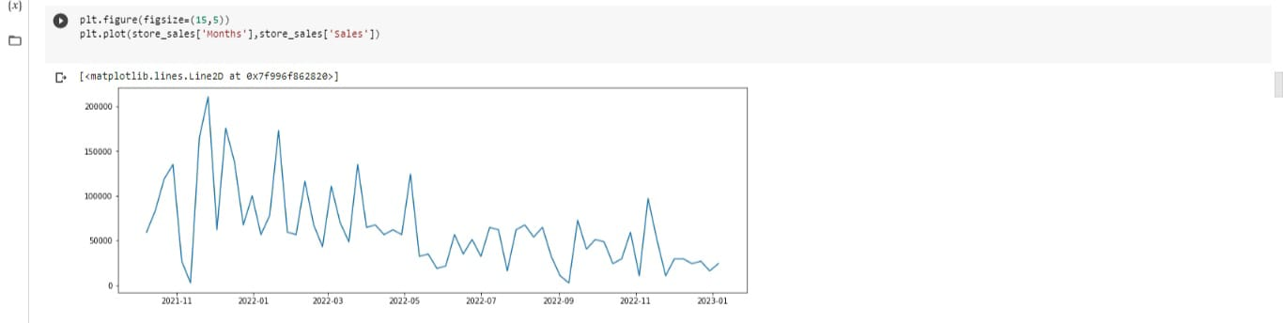

Slide 15
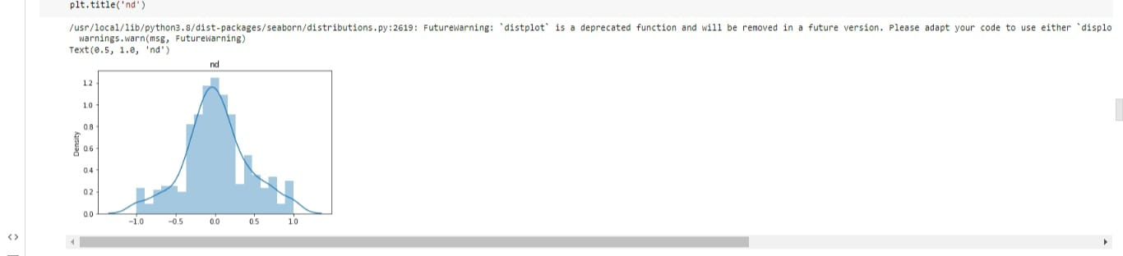

Slide 16
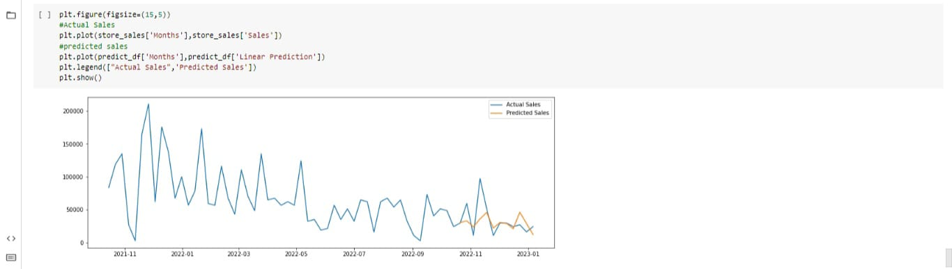

Slide 17
Advantages:
More flexible
Adaptive than traditional methods
Analyze a wide range of data
Historical sales data
Weather patterns,
Social media data
Accurate prediction
Easily updated

Slide 18
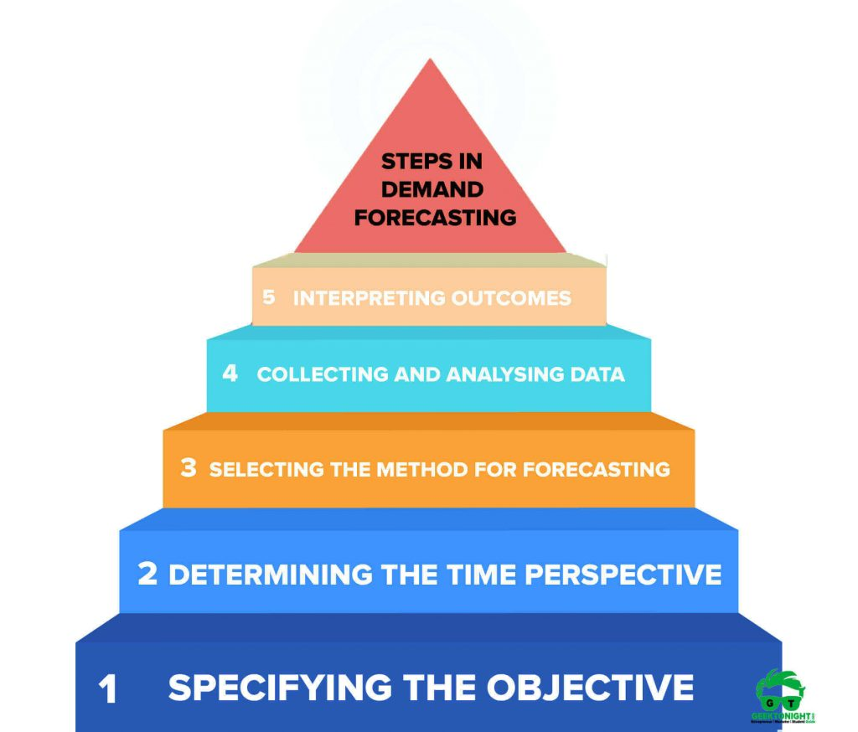

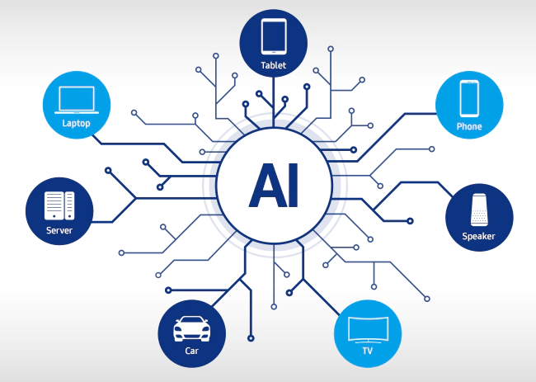
Steps for Forecasting

Slide 19


Slide 20
